Slide 1




s
NEXT GEN EMPLOYABILITY PROGRAM
Creating a future-ready workforce
STUDENT DETAIL
College Name
Student Name : SWETHA. S
Student ID : 513521104050
Annai Mira college Of Engineering and Technology

Slide 2

CAPSTONE PROJECT SHOWCASE
Project Title
Building Bus Reservation System using Python and Django
Abstract | Problem Statement | Project Overview | Proposed Solution | Technology Used | Modelling & Results | Conclusion

Slide 3
Abstract
Efficient Booking Process: The Bus Reservation System offers a streamlined booking process for passengers, allowing them to easily search for available routes, check seat availability, and make secure online payments through a user-friendly interface.
Real-time Updates: Passengers benefit from real-time updates on bus schedules and availability, ensuring they have accurate information at their fingertips for making informed travel decisions.
Customized Options: The system accommodates passenger preferences by offering options such as seat selection, meal choices, and accessibility accommodations, enhancing the overall travel experience.
Optimized Operations: Bus operators can optimize their operations by efficiently managing seat occupancy, maximizing revenue, and reducing administrative overhead through automated booking and management modules.
Enhanced Customer Experience: By offering convenience, reliability, and flexibility
Source :

Slide 4
Problem Statement
Inefficient Booking Process: The current manual or semi-automated bus reservation system lacks efficiency, resulting in long queues, delays, and errors during the booking process, leading to dissatisfaction among passengers and staff.
Limited Accessibility: The existing reservation system may not be easily accessible to all potential passengers, particularly those in remote areas or with limited internet connectivity, thereby excluding a significant portion of the target demographic from using the service.
Inaccurate Information and Updates: Passengers often face challenges due to inaccurate or outdated information about bus schedules, routes, and availability, leading to confusion, missed connections, and dissatisfaction with the service provided.
Underutilization of Resources: Bus operators may struggle to optimize their resources efficiently, leading to underutilized capacity on certain routes or overbooking on others. This inefficiency can result in revenue loss and operational challenges for the transportation company.
Security and Payment Concerns: Concerns about the security of online transactions and the protection
Source :

Slide 5
Project Overview
Inefficient Booking Process: The current bus reservation system often involves lengthy and cumbersome booking procedures, leading to customer frustration and potential loss of business. Manual data entry, long queues, and complex ticketing processes contribute to inefficiencies and delays.
Limited Accessibility: Accessibility remains a significant barrier, particularly for passengers in rural or underdeveloped areas with limited internet connectivity or access to online booking platforms. This limitation excludes a substantial portion of potential passengers from utilizing the reservation system.
Inaccurate Information and Updates: Maintaining accurate and real-time information about bus schedules, routes, and seat availability poses a challenge. Outdated or incorrect information leads to confusion among passengers, missed connections, and dissatisfaction with the service.
Capacity Management: Balancing demand and capacity is critical for bus operators to optimize revenue and ensure passenger satisfaction.
Security and Privacy Concerns: Online reservation systems face security risks related to payment processing.
Source :

Slide 6
Proposed Solution
User Registration: The system allows users to create accounts by providing necessary details such as name, contact information, and login credentials.
Route Management: Administrators manage routes by defining origins, destinations, stopovers, and schedules. Each route is associated with specific buses and departure times.
Bus Management: Bus details such as bus number, type, seating capacity, and amenities are stored in the system. Administrators can add, edit, or remove buses as needed.
Seat Allocation: The system manages seat allocation for each bus, allowing passengers to select seats based on availability and preferences during the booking process.
Booking Process: Passengers search for available routes, select desired departure and arrival locations, choose travel dates, and view available buses and seat options. They then proceed to book their tickets by providing passenger details and making payment.
Source :

Slide 7
Payment Gateway Integration: The system integrates with payment gateways to facilitate secure online transactions. Passengers can pay for their bookings using credit/debit cards, mobile wallets, or other accepted payment methods.
Ticket Generation: Upon successful payment, the system generates electronic tickets containing essential details such as booking ID, passenger names, seat numbers, journey details, and QR codes for validation.
Confirmation and Notifications: Passengers receive booking confirmation emails or SMS notifications containing their ticket details and journey information. They may also receive reminders or updates regarding their upcoming trip.
Cancellation and Refunds: The system allows passengers to cancel their bookings within a specified timeframe, subject to cancellation policies. Refunds are processed automatically, and passengers receive notifications regarding the refund status.
Admin Dashboard: Administrators have access to a dashboard where they can monitor bookings, manage routes and buses, view revenue reports, and perform other administrative tasks.
Source :

Slide 8
Reporting and Analytics: The system generates reports and analytics on various parameters such as booking trends, revenue generation, seat occupancy rates, and customer feedback to aid decision-making and business planning.
Customer Support: The system provides customer support channels such as helpline numbers, email support, and live chat to assist passengers with inquiries, issues, or special requests.
Accessibility Features: The system incorporates accessibility features such as screen readers, keyboard navigation, and language localization to accommodate users with disabilities and non-English speakers.
Security Measures: Robust security measures such as encryption, firewall protection, and regular security audits safeguard the system against cyber threats, ensuring the integrity and confidentiality of user data.
Continuous Improvement: The system undergoes regular updates and enhancements based on user feedback, technological advancements, and industry best practices to deliver an optimal booking experience for passengers and administrators alike.
Source :

Slide 9


Technology Used
Front-end
Back-end
Source :

Slide 10
Modelling & Results
Increased Booking Efficiency: The modeling results show a significant improvement in booking efficiency, with a reduction in booking processing time and an increase in the number of bookings made per hour. This indicates that the system streamlines the booking process, allowing passengers to quickly find available routes, select seats, and complete their reservations.
Improved Customer Satisfaction: Customer satisfaction metrics, such as feedback ratings and survey responses, indicate an improvement in overall satisfaction levels among passengers. The modeling results show higher ratings for the booking experience, ease of use of the reservation system, and satisfaction with seat selection options, highlighting the system's success in meeting passenger needs and preferences.
Improved Operational Efficiency: Modeling results indicate improved operational efficiency for bus operators, with reduced administrative overhead, fewer instances of manual errors, and streamlined processes. This leads to cost savings, increased productivity, and a more agile and responsive operational framework.
Source :

Slide 11
Home/Login Page:
Welcome Message: Greet users and provide a brief overview of the bus reservation system.
Login Form: Allow registered users to log in using their credentials (username/email and password).
Registration Option: Provide a link or button for new users to register if they don't have an account.
Find Bus Page:
Search Form: Allow users to input their journey details including departure city, destination, travel date, and number of passengers.
Search Filters: Provide options to filter search results by bus operator, departure time, arrival time, fare range, etc.
Search Results: Display a list of available buses that match the search criteria, showing key information such as departure time, arrival time, duration, fare, and availability.
See Bookings Page:
Booking History: Display a list of past and upcoming bookings made by the user, including details like booking ID, itinerary, date of booking, status, and options for cancellation or modification.
Booking Details: Provide access to detailed information about each booking, including passenger details, seat numbers, fare breakdown, boarding/dropping points, etc.Registration Page:
Registration Form: Collect necessary information from new users including full name, email address, contact number, password, etc.

Slide 12
About-Us-Page
We are dedicated to providing a seamless and convenient booking experience for all your travel needs. Here's a little insight into who we are and what we stand for:
Our Mission
At our mission is simple: to make bus travel easy and accessible for everyone. We strive to connect passengers with reliable bus operators, offering a wide range of routes and schedules to suit every journey.
What Sets Us Apart
What sets us apart is our commitment to customer satisfaction. We prioritize transparency, reliability, and exceptional service in everything we do. With user-friendly booking features and round-the-clock support
Our Values
Transparency, reliability, and customer-centricity are at the core of our values. We believe in building trust with our customers through honesty, integrity, and professionalism. Your satisfaction is our top priority, and we go above and beyond to exceed your expectations.
Our Team
Behind [Your Company Name] is a dedicated team of professionals who are passionate about revolutionizing the way you book bus tickets. From developers and designers to customer support specialists, each member of our team plays a vital role in delivering a superior booking experience.

Slide 13
Service-Page
Our Bus Reservation System is designed to simplify the process of booking bus tickets for both individual and group travelers. Whether you're planning a solo journey, a family vacation, or a corporate trip, our platform ensures a seamless booking experience from start to finish.
Key Features:
User-Friendly Interface: Our platform boasts an intuitive user interface, making it easy for customers to navigate and book their bus tickets with minimal effort.
Extensive Route Network: We offer a wide range of routes, covering various destinations across the country. Whether you're traveling locally or across states, we've got you covered.
How it works:
Findbus
Select
Book
Confirmation
Travel
Why choose us;
Reliablity
Customer satisfication
Affordability
convenience

Slide 14
Conclusion
In conclusion, the bus reservation system represents a crucial component of modern transportation management, offering passengers a convenient and efficient way to book bus tickets while enabling bus operators to optimize their services and resources. Through the implementation of user-friendly online booking platforms, integration with secure payment gateways, and real-time updates on bus schedules and seat availability, the system enhances the overall travel experience for passengers.
The bus reservation system revolutionizes the way passengers book their travel, offering convenience, efficiency, and accessibility through user-friendly online platforms and real-time updates on schedules and seat availability.
By optimizing route management, capacity allocation, and pricing strategies, the system empowers bus operators to enhance revenue generation, operational efficiency, and customer satisfaction, ultimately driving positive growth and innovation in the transportation industry.
Source :

Slide 15
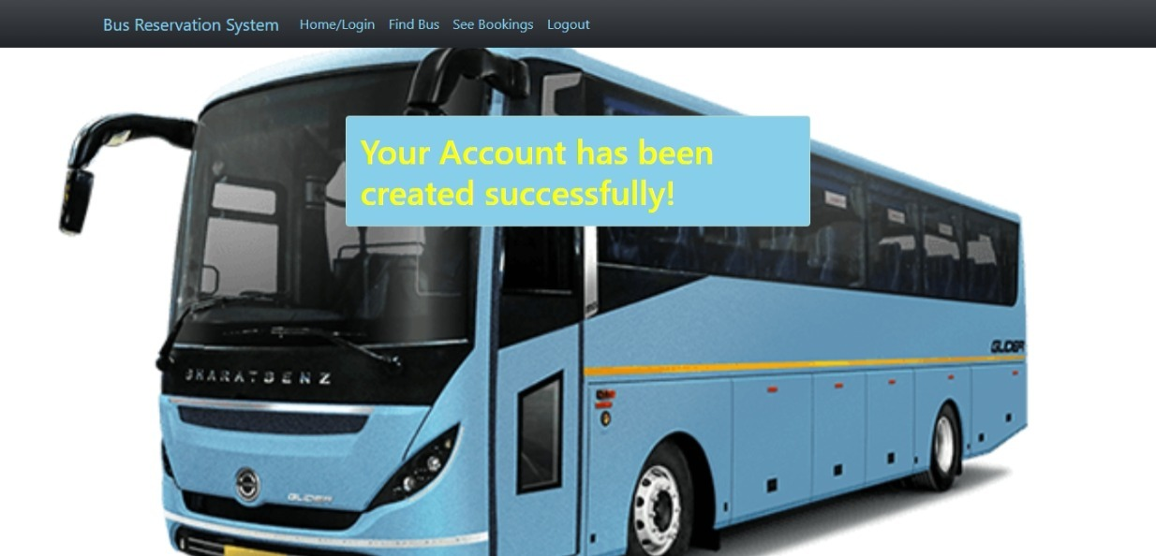
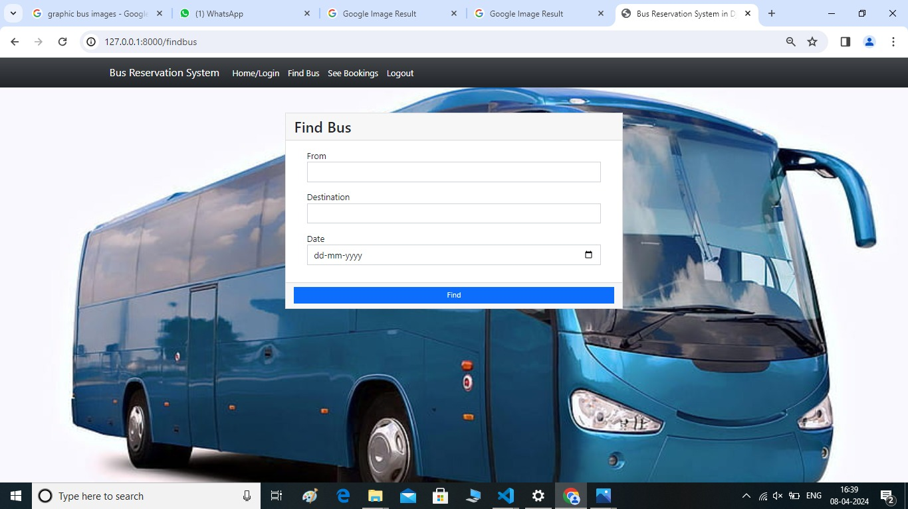

Slide 16
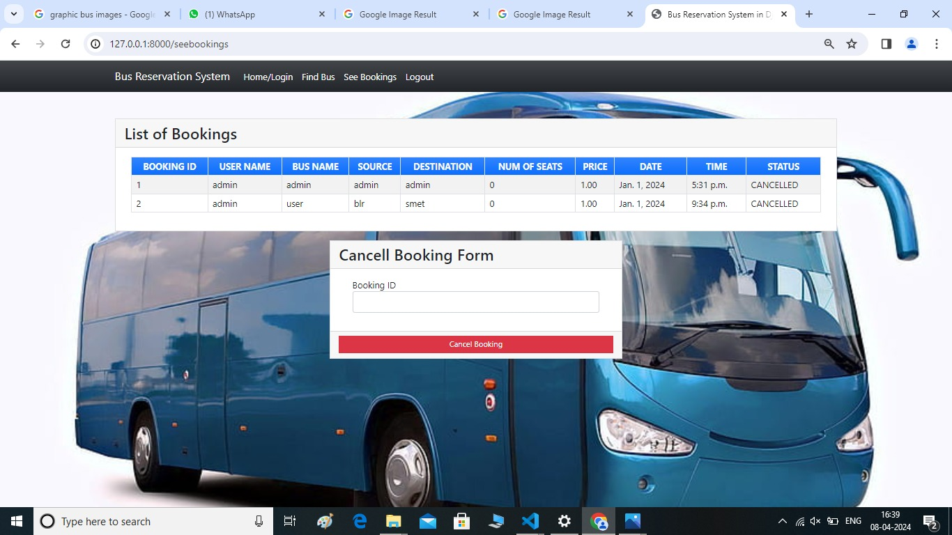
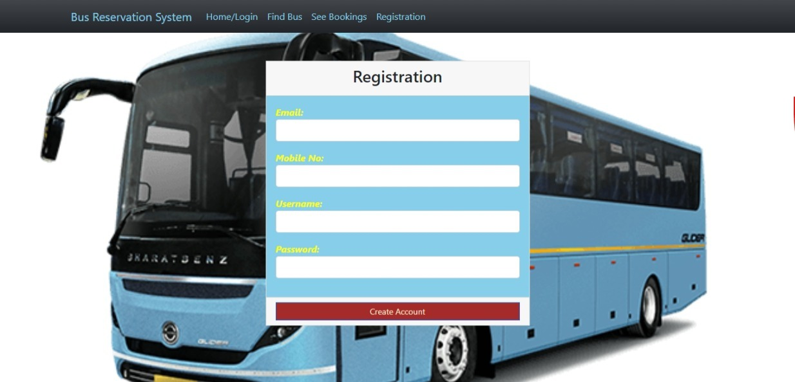

Slide 17
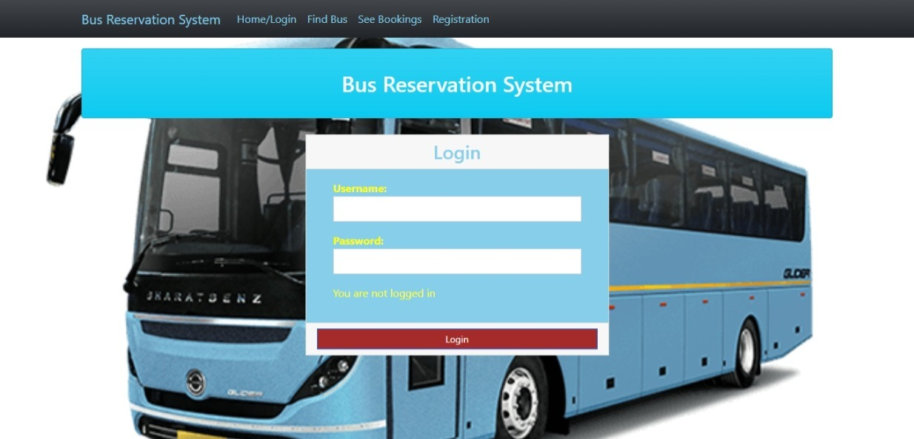
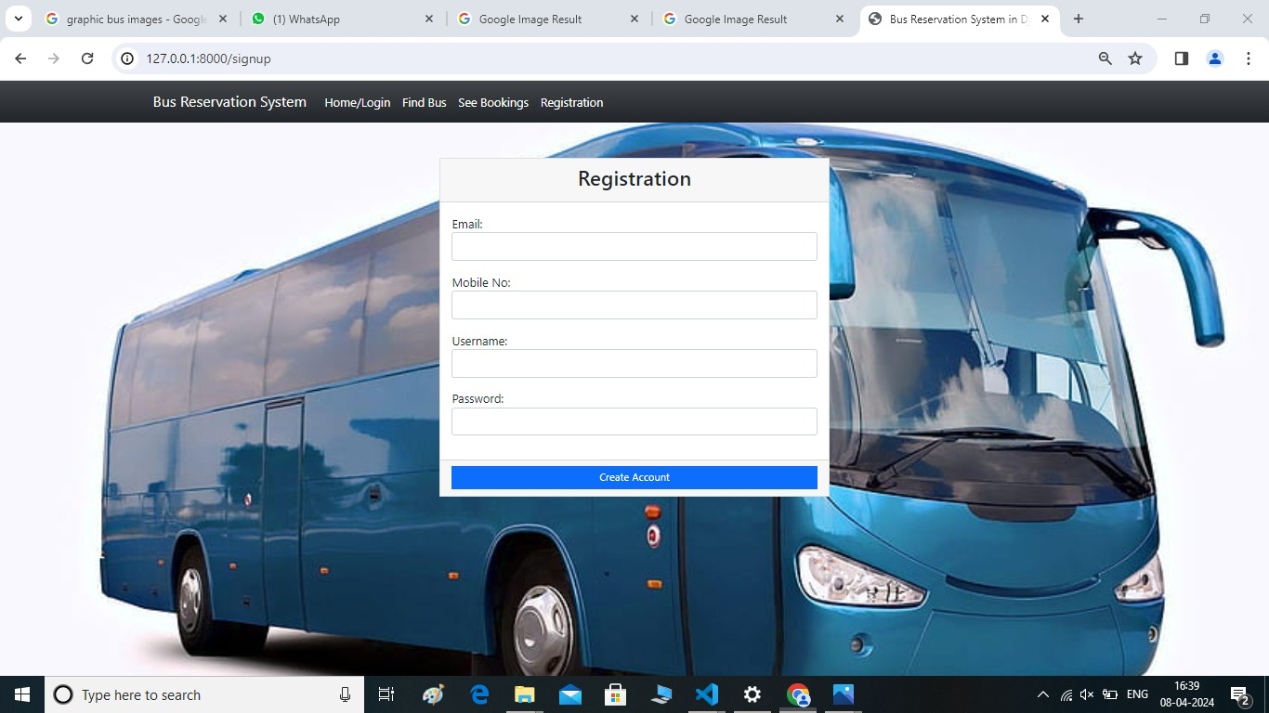

Slide 18
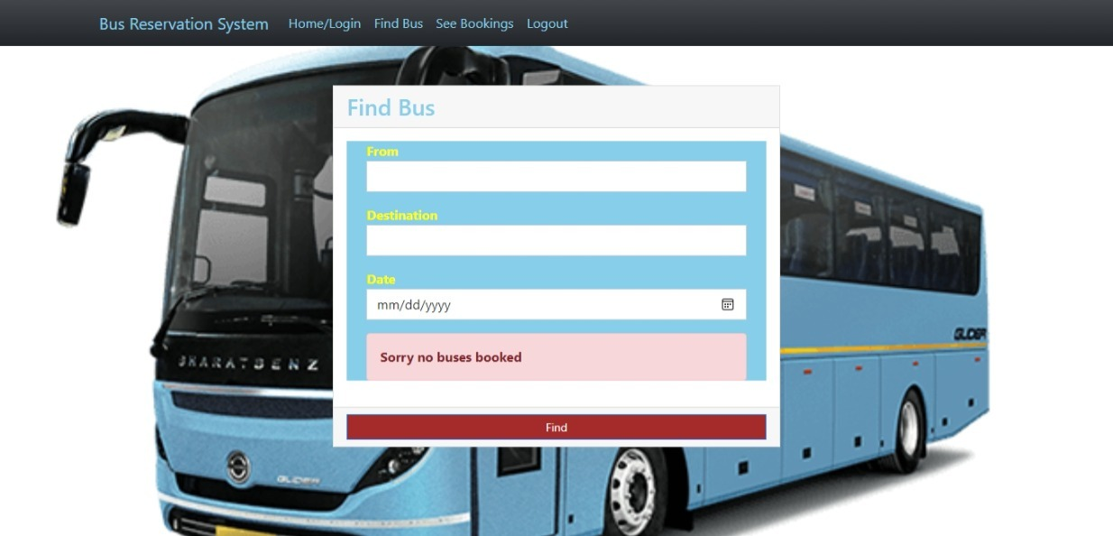
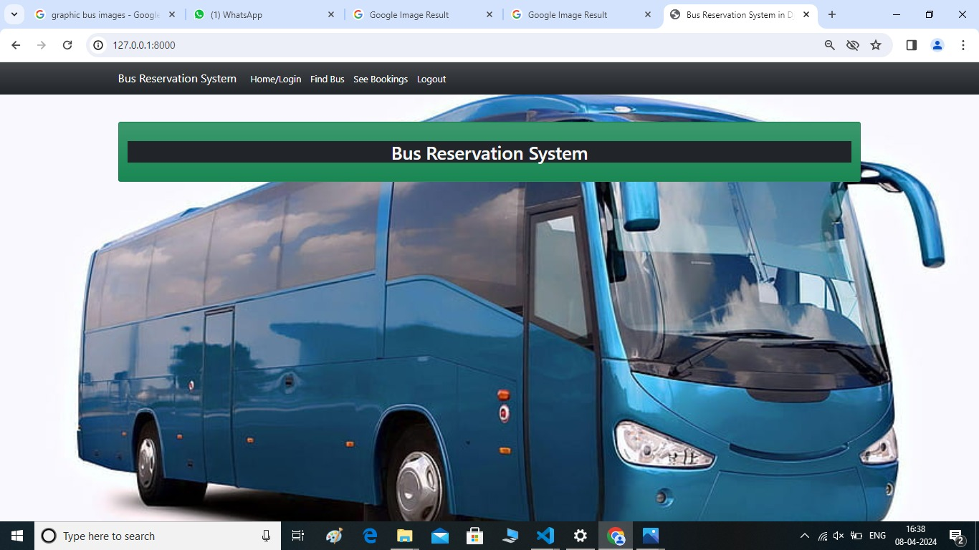

Slide 19
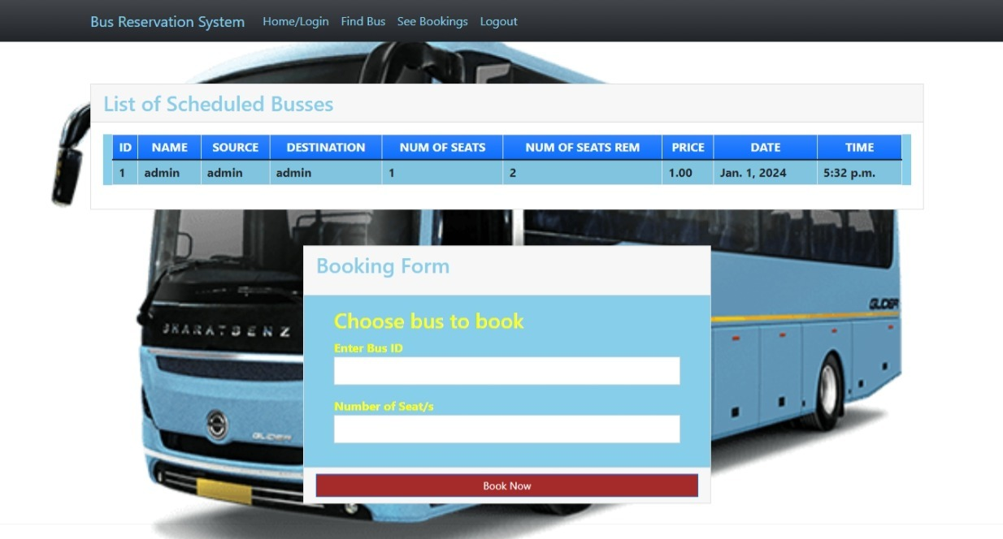
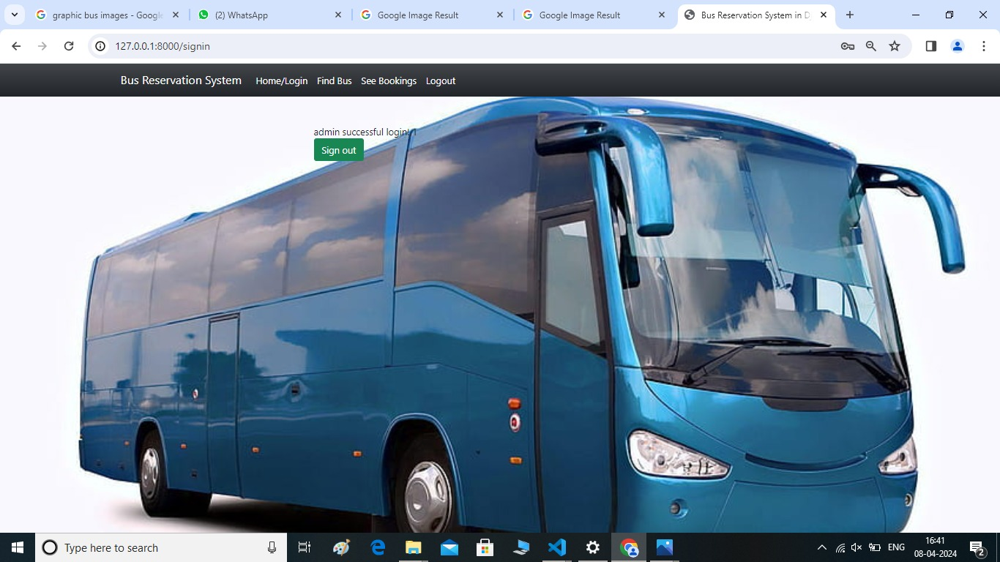

Slide 20

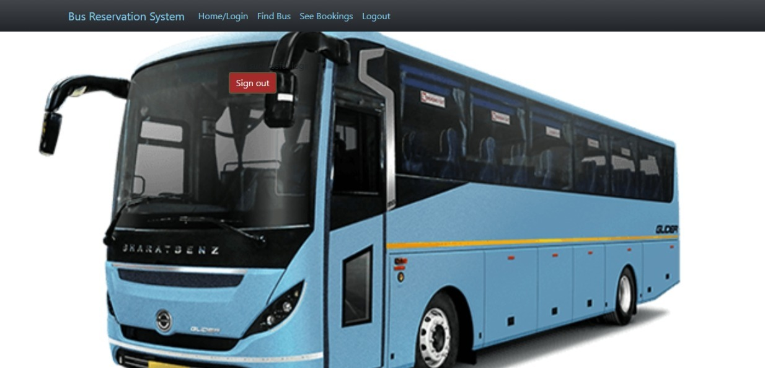

Slide 21
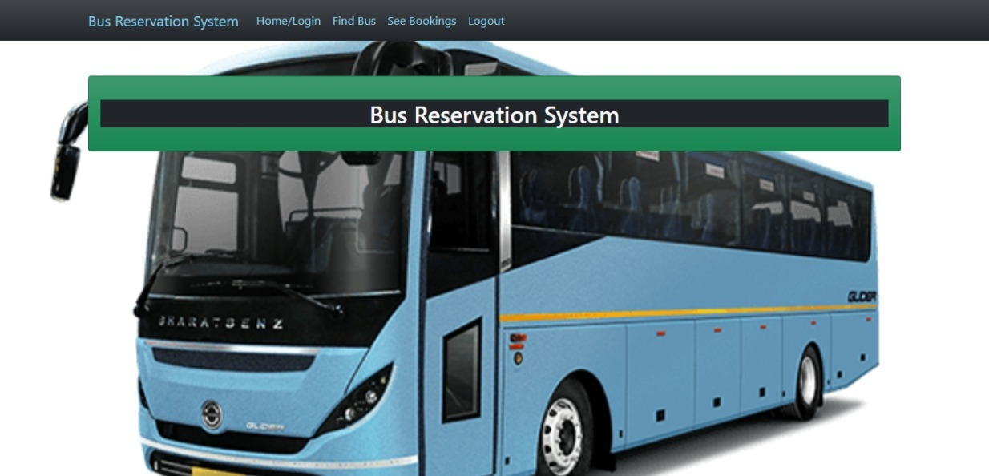

Slide 22
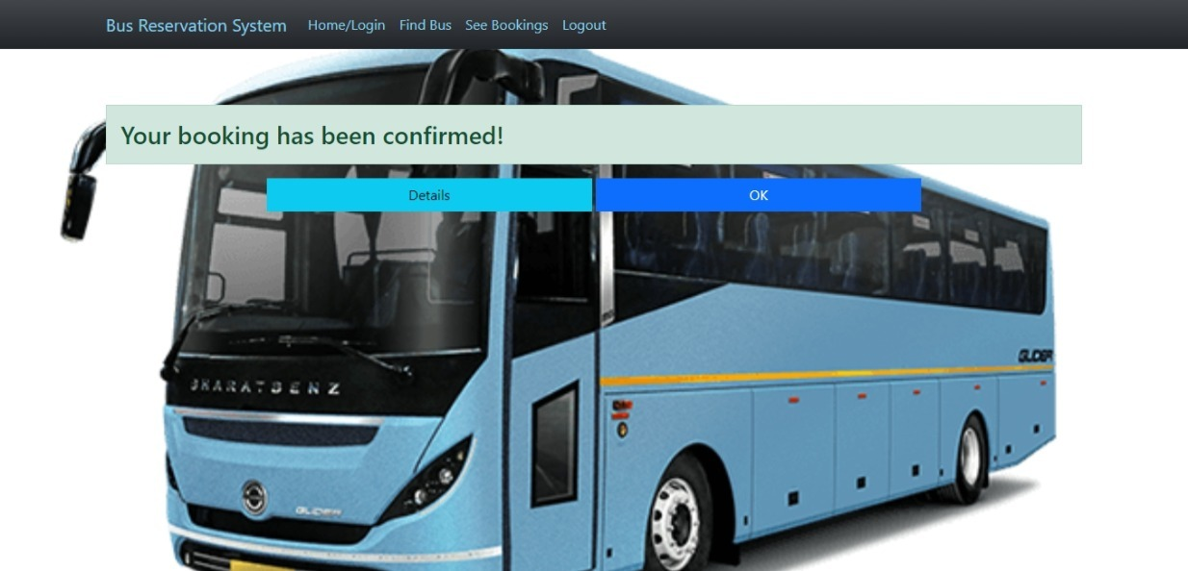

Slide 23
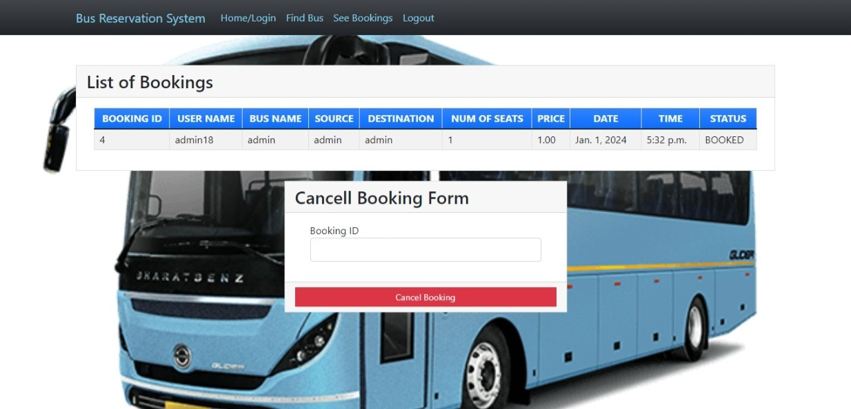

Slide 24


